Slide 1
Bike Sharing -Case Study
GOOGLE DATA ANALYTICS CAPSTONE
BY AMIT BHATTE

Slide 2
ABOUT ME
I am a Software Engineer working on .NET web development since past 10+ years. As a part of my work I have closely worked with data by capturing it and saving it in the software applications.
I was always inquisitive about how data could influence a business and what value addition it can make in a company’s strategy making. This made me take a deep dive into data analytics and I got interested in the Google data analytics course.

Slide 3
CYCLISTIC
Bike sharing company in Chicago, U.S.
Fleet of 5,824 bicycles & 692 docking stations across Chicago.
Bicycle portfolio ranges from reclining bikes, hand tricycles, to cargo bikes.
Cyclistic app users: 30% users use for office commute remaining 70% use for leisure.

Slide 4
OBJECTIVES
Maximizing the number of annual members by converting casual riders into members.
Why should casual riders consider buying membership?
How do annual members and casual riders use Cyclistic bikes differently?

Slide 5
ABOUT THE DATA
The data is provided by Motivate International Inc under data license agreement.
This data is public and consists of 12 months of data ranging from Jan-2023 to Dec-2023.
Due to data privacy, information about user purchases for ride plans is not available.

Slide 6
ABOUT THE DATA (CONT.)
Since the company is based out in Chicago, the data is assumed to be for the same city.
The total distance travelled for the trip by rider is not available, instead start and end co-ordinates are mentioned.
There are some missing values in the data and there are some errors is data collected.
Due to the missing data and errors in the data, the integrity of data is not ascertain.

Slide 7
PROCESS
SQL used to save the bike riders data.
Original .csv data was imported in SQL database.
For relevance, only the bike type, start date and end date were imported from .csv files.
Additional calculated fields were derived to find out start/end day, month, date and timestamp.
Tableau used to visually represent data.

Slide 8
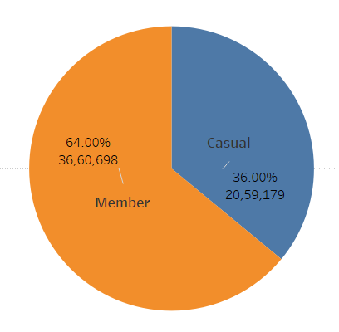
Member v/s Casual
In 2023, 64% were MEMBER riders and 36% are CASUAL riders.
Total riders 57,19,877

Slide 9
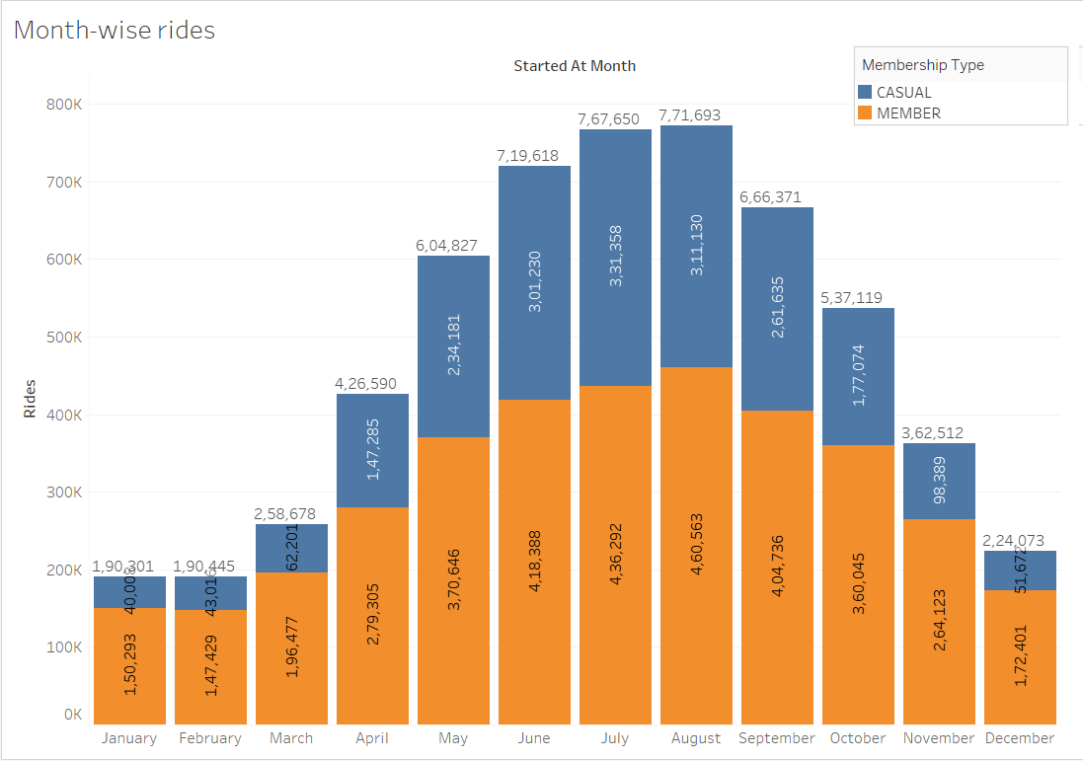
Month-wise Rides
Highest rides are 7,71,963 during month of August 2023.
For summer time in Chicago (Jun-Aug) there are maximum rides.
Lowest rides during winter months (Nov-Mar).
No. of members follow same pattern as rides.
Lowest rides are 1,90,301 during month of January 2023.

Slide 10
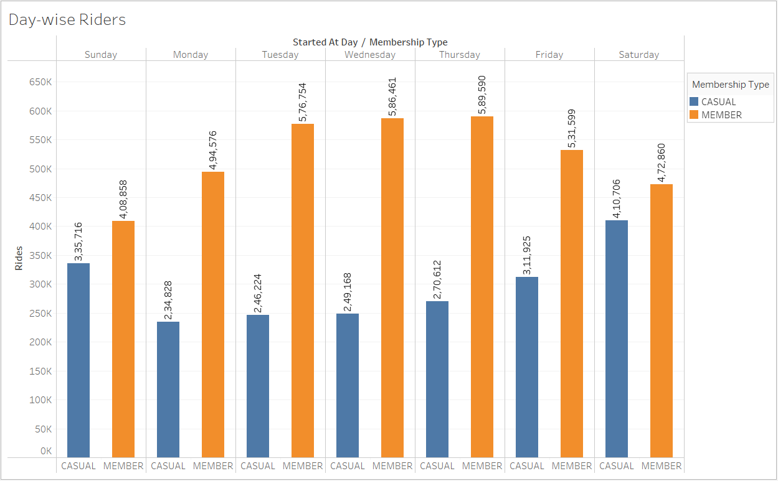
Day-wise Rides
On weekends, number of rides are almost same by member & casual riders.
More rides during weekdays as compared to weekends.

Slide 11
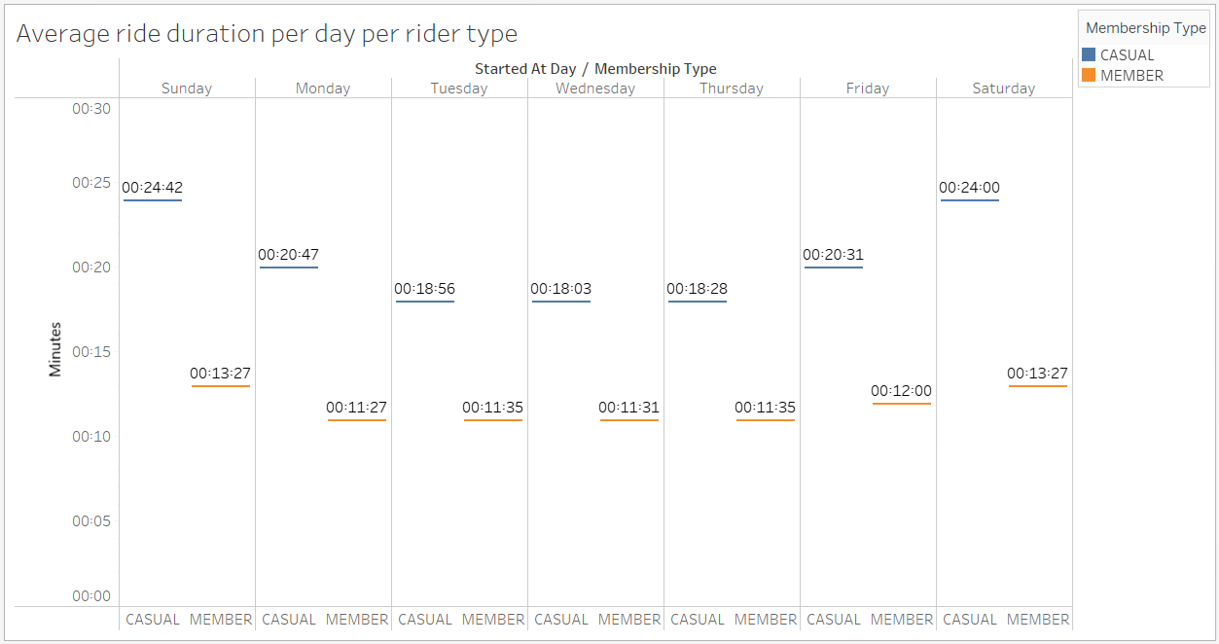
Average trip duration for riders per day
Casual riders ride more than Member riders.
Casual riders ride the most during weekends.
Member riders ride almost for same duration on weekdays.

Slide 12
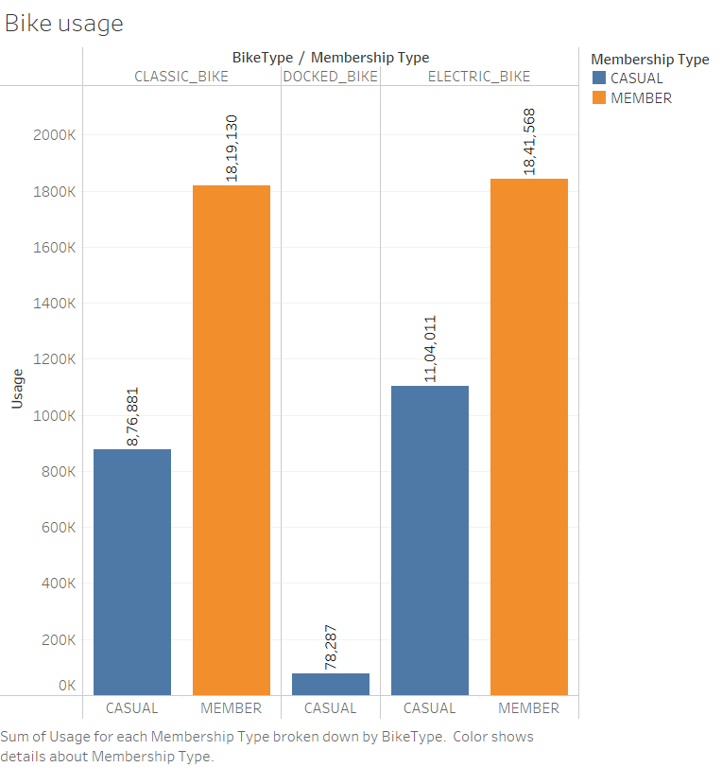
Types of Bikes
Classic |  | Docked | Electric
Casual | Member | Casual | Casual | Member
8,76,881 | 18,19,130 | 78,287 | 11,04,011 | 18,41,568
26,96,011 |  | 78,287 | 29,45,579
Riders using CLASSIC bike are 32.52% casual riders & 67.47% Member riders.
Only Casual riders use DOCKED bike.
Riders using ELECTRIC bike are 37.48% casual riders & 62.52% Member riders.

Slide 13
FINDINGS
Casual riders use bikes the most during summer time in Chicago as compared to member riders.
The number of rides done by Casual riders is almost close to Member riders only during weekends.
Casual riders have longer trip durations during weekends than member riders. Member riders have almost same trip durations during weekdays implying use for work/job related commute.
Only casual riders use docked bikes and not member riders.

Slide 14
RECOMMENDATIONS
New membership offers for casual riders especially during summer season.
Membership benefits to casual riders during weekends for longer trips.
Loyalty program exclusive for members which can offer discounted trips.

Slide 15
The End

